Slide 1
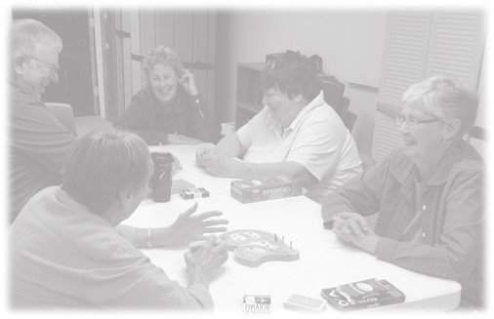
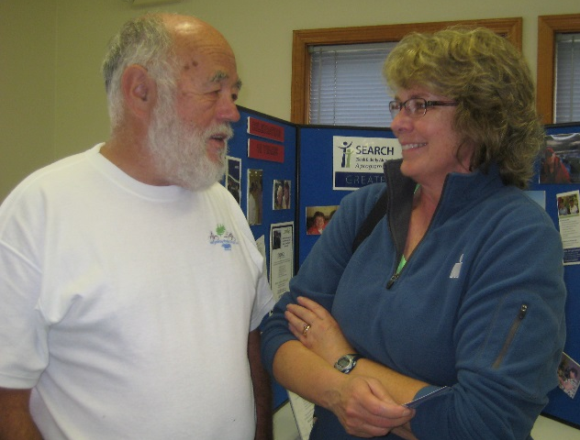
Bowdoinham, Maine: Member of the WHO-GNAFCC & AARP-NAFC William Post, MPA Town Manager

Slide 2
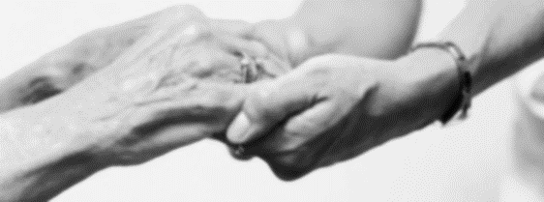
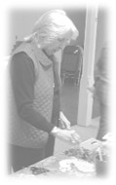
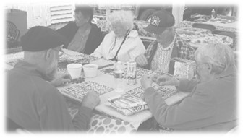
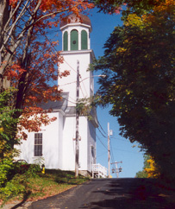
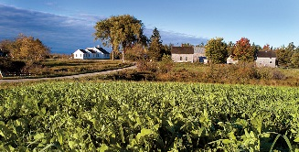
Bowdoinham
Population: 2,889 spread across 39.2 square miles
Rural community in a resource rich region of Maine
Median age is 43.7 with 19.8% of residents aged 60 or older
Between 2000 and 2014, the overall population grew by 10% but the number of residents between the ages of 65 and 74 grew by 88%.

Slide 3
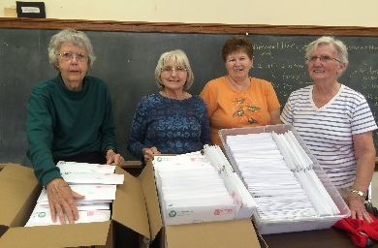
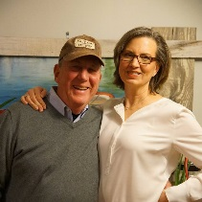
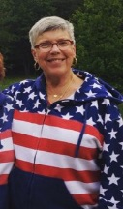
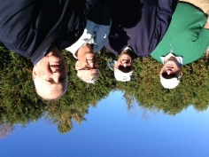
2012: Needs Identified
Information
Organization
Transportation
Housing
Gathering Space
Information - About community activities, services and access to services
Organization - Need for coordinated leadership and advocacy for older residents
Transportation – Limited availability of public transportation
Housing – Lack of community-based congregate or assisted living; lack of in-home affordable chore services and home repairs
Gathering space – for socialization, games, activities, exercise
Notes:
In 2012, recognizing the challenges and opportunities of an aging population, as part of its Comprehensive Planning Process, the Town of Bowdoinham conducted a needs assessment to identify the strengths and the weaknesses of the community for aging in place. These are the results.

Slide 4
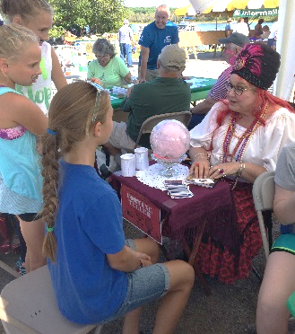
What We Did
Select Board appointed ACOA – 7 to 9 members
Activity and Resource List now Requested by residents
Coordinator works 15 hrs/wk; in 2nd year, liaison between older residents and administration; Knowledge of Aging Issues
Always held a senior lunch, now exercise classes, card games, talks by town officials, social gathering space, programs by others (sheriff, etc)
Advisory Committee on Aging Created – Residents appointed to provide advice and solutions to Select Board and Town Manager
Information – Activity and Resource List distributed by mail and email; keeps residents aware of activities and resources
Organization – Administration created Coordinator of Older Adult Services position to provide leadership and advocacy for older residents
Transportation – Volunteer rides program; Town exploring bus transportation
Gathering space – Space utilized in local church, town office and fire station for activities, programs and exercise
Notes:
In response to the findings of the needs assessment, the Select Board appointed seven Bowdoinham residents to serve on the Advisory Committee on Aging.
The purpose of the Advisory Committee on Aging is two-fold. They advise the Select Board and manager about policies and infrastructure changes that will support aging in place. The Committee has recommended changes to increase accessibility of town owned buildings and public spaces that have been implemented by the Town Manager and staff.
The Committee also tries to increase the recreational and social opportunities available to older residents.
In the last three years, The Advisory Committee on Aging has sponsored a senior center, volunteer-led exercise and recreational programs, lifelong learning opportunities, local trips, & an annual aging well(ness) fair.
In 2014, Bowdoinham became a member of the WHO-GNAFCC (Global Network of Age Friendly Cities & Communities), the first municipality in northern New England to join the network. In 2015, Bowdoinham joined the AARP-NAFC (Network of Age Friendly Communities).
The Select Board did not want ACOA to create services—such as transportation, a chore service, and care partner support—but to increase connections with existing services and to foster the creation of volunteer-led initiatives.

Slide 5
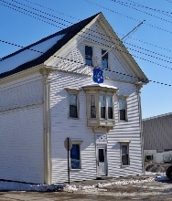
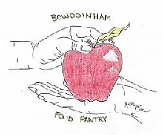
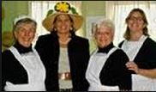
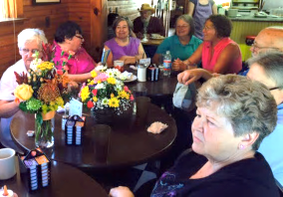
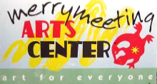
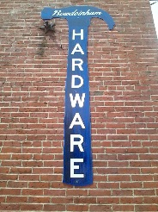
Community Connections
Bowdoinham Fire Department and EMS
Bowdoinham Food Pantry
Bowdoinham Town Library
Bowdoinham Historical Society
Local Health Officer
Merrymeeting Arts Center
Town Landing (restaurant)
Bowdoinham Hardware Store
Second Baptist Church
Bowdoinham Nazarene Church
Bowdoinham Estates
Notes:
Age-friendly communities emphasize collaborations and partnerships to create age-friendly changes in the social and physical environments of municipalities. The Advisory Committee on Aging has partnered with traditional aging service providers—such as Visiting nurses, the Alzheimer’s Association and AAAs to effect change. They have also partnered with these organizations in town.
Bowdoinham Fire Department & EMS—Durable Equipment loan program, space, Co detector program
Food Panty—based on need, working with ACCESS health, created opportunity for residents—users and non-users of the food pantry—to take a class on frugal but healthy eating
Library—age-friendly library initiative and all the pilots
Historical Society—guidance for changes in accessibility that honored the historic nature of the town offices; co-sponsorshipof programming
Etc……

Slide 6
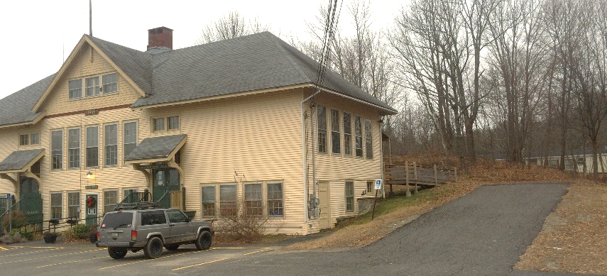
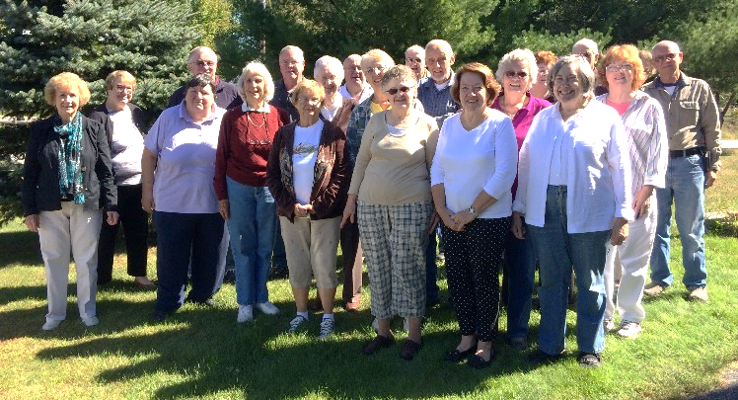
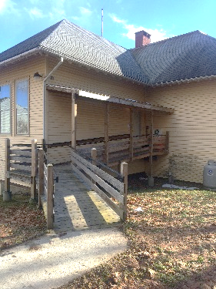
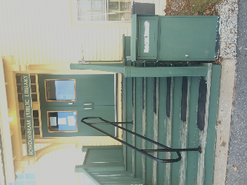
The benefits?
Access to Outdoor Spaces & Public Buildings
Social Participation
Respect & Social Inclusion
Work & Civic Engagement
Communication & Information
Community & Health Services
Benefits for residents of all ages
Increased civic engagement by older residents
Stronger Community Connections
Economic Development
Notes:
Beside the worldwide recognition Bowdoinham has received for its commitment to making aging-friendly changes…People feel good about living in a place that gets so much attention for the work it has done to make the community a better place for people of all ages and abilities.
Bill—Under benefits for residents of all ages, I talk about the changes you made in accessibility at the park—the wider paths benefit people using a walker/wheelchair but also benefits people walking a dog, couples walking side-by side, dad teaching his 3-year old daughter to ride a bike… Additional seating Nicole added at Celebrate is enjoyed by all. The heated stair treads and center railing on the steps make it safer for everyone to enter the library
Under increased civic engagement, I talk about things like Rides INC and the Handy brigade that not only meet a need but also increases relationships in the community and allow older adults to volunteer/feel productive. Your work in Bowdoinham has increased involvement of older adults in various community groups—including food pantry, library, etc.
Stronger community connections. Older residents are included in town-wide activities like Celebrate Bowdoinham, encouraged to remain involved in the community—following pattern of a lifetime. In an Bowdoinham, because of the changes you have made, residents are able and encouraged to actively participate in all aspects of community life. People of all ages, backgrounds and circumstances can interact, share experiences and contribute.
Economic Development. Even in small towns, there are benefits for businesses that cater to older adults. We know that older adults prefer to shop locally. Businesses win when they encourage older residents to patronize them. For example, ACOA partnered with the hardware store to provide access to tools featured on our tool table (not available at box stores in Topsham/Brunswick). Win for the hardware store—increased business. Win for older residents who can purchase needed items. Town Landing puts together a once/month luncheon for older residents followed by Trivia. Increases her business, not just for the once/month luncheon.

Slide 7
Conclusions
For more information about the age-friendly initiative in Bowdoinham, Maine:
William Post
Town Manager
13 School Street
Bowdoinham, Maine 04008
Email: wpost@Bowdoinham.com

